Slide 1

RESFINO
RETAIL SALES FORECAST
AND
INVENTORY OPTIMIZATION
Guided by: Dr. EBIN DENI RAJ Presented BY: HARSH SINGH
2015BCS0012

Slide 2
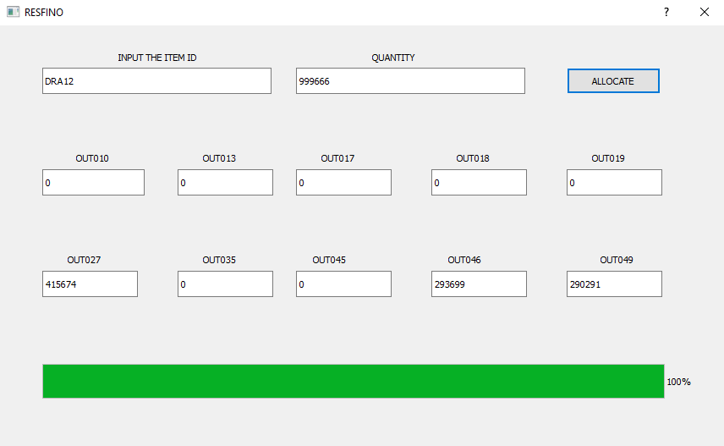

Slide 3
Table of contents
Introduction
Abstract
Literature survey
Preliminary Work
Existing model in market
DATASET
Architecture model
Result and discussion
References

Slide 4

introduction
Sales forecasting can play a major role in EVERY company's success.
Companies can base their forecasts on past sales data, industry-wide comparisons, and economic trends, locality.
Sales forecasting gives insight into how a company should manage its workforce, cash flow, and resources.

Slide 5
abstract
The main objective is to understand whether specific properties of products and stores play a significant role in terms of increasing or decreasing sales volume. To achieve this goal, we will build a predictive model and find out the sales of each product at a particular store. This will help BigMart to boost their sales by learning optimised product organization inside stores. Finally make a software to automate the optimization of inventory so that sales can be maximized.

Slide 6
Previous work & Relation
I Had made “ E- Transactions Fraudulent detection System”
that dataset was a financial dataset which contains more than 2.6 lacs entries and with the help of attributes like time, class, many pca values, i was classifying the transactions into fraud and genuine transactions.
For the classification of the transactions, I developed a new architecture and algorithms by combining the best suitable algorithms for our dataset which are available in the market.

Slide 7
Literature survey
Paper name | Date | Conclusion
Traffic Management using Logistic Regression with Fuzzy Logic Temporal Data Mining via Unsupervised Ensemble Learning, AS Tomar, M Singh, G Sharma, KV Arya - Procedia Computer Science, 2018 – Elsevier | 2018 | In this paper, They have proposed a real time traffic information for intelligent decision making to decide the route preference is required. Some certain parameters such as distance, weather condition, road location, day of week and time are considered to formulate the problem and to find solutions to these problems. This paper outlines a combination of logistic regression with fuzzy logic such that a smart decision to preferred path can be taken. Traffic management problem can be seems as like an inventory management. Somewhere it is more crowded and somewhere its less crowded. Now we have to manage it so that crowd can be optimized.

Slide 8
Paper name | Date | Conclusion
An Optimization Approach to Services Sales Forecasting in a Multi-staged Sales Pipeline Cloud Services Analytics Group IBM Almaden Research Center IEEE International Conference on Services Computing (SCC) | June 2016 | In this paper, they formulated this problem, considering the service-specific context, as a machine learning problem over the set of historical services sales data. They introduced a optimization approach for finding the optimized weights of a sales forecasting function. They evaluated the presented method, with the existing method without weights then they come to conclusion that their method was having superior performance (in terms of absolute and relative errors) compared to basic method.

Slide 9
Paper name | Date | Conclusion
Multi-Objective Evolutionary Feature Selection for Online Sales Forecasting Neurocomputing Volume 234, Pages 75-92 Elsevier | 19 April 2017 | Here they have made a regression model for online sales forecasting obtained via a novel feature selection methodology by the application of the multi-objective evolutionary algorithm ENORA (Evolutionary non-dominated Radial slots-based Algorithm). Then they have also used Random Forest algorithm. They have integrated feature selection for regression, model evaluation, and decision making, in order to choose the most satisfactory model.
Towards Context Aware Food Sales Prediction ICDMW 2009 IEEE International Conference on Data Mining Workshops | 2009 | In this context aware sales prediction approach, they have selected the base predictor depending on the structural properties of the historical sales. They have also shown how the dependencies between product categorization accuracies and sales prediction accuracies.

Slide 10

Paper name | Date | Conclusion
A Comparative Study of Supervised Machine Learning Algorithms for Stock Market Trend Prediction 2018 Second International Conference on Inventive Communication and Computational Technologies (ICICCT) IEEE 27 September 2018 | 27 September 2018 | In this paper, many machine learning techniques have been applied for the stock price prediction in order to overcome difficulties. In the implemented work, five models have been developed and their performances are compared in predicting the stock market trends. These models are based on five supervised learning techniques i.e., Support Vector Machine (SVM), Random Forest, K-Nearest Neighbour (KNN), Naive Bayes. The experimental results show that Random Forest algorithm performs the best for large datasets and Naive Bayesian Classifier is the best for small datasets. The results also reveal that reduction in the number of technical indicators reduces the accuracies of each algorithm.

Slide 11
Paper name | Date | Conclusion
A survey of machine learning techniques for food sales prediction S Ren, CP Hui, TJ Choi - Artificial Intelligence Review, Artificial Intelligence for Fashion Industry in the sales prediction 2018 – Springer | 2018 | This paper reviews existing machine learning approaches for food sales prediction. It discusses important design decisions of a data analyst working on food sales prediction, such as the temporal granularity of sales data, the input variables to use for predicting sales and the representation of the sales output variable. Finally, it discusses the main challenges and opportunities for applied machine learning in the domain of food sales prediction.
General Sales Forecast Model for Automobile Markets and their Analysis Industrial Conference on Data Mining ICDM 2011, Springer M Hülsmann, D Borscheid, CM Friedrich, D Reith - Trans. MLDM, 2012 Page 255-269 | January 2011 | The German and the US-American automobile market are presented for the evaluation of the forecast models. In this paper, various enhanced sales forecast methodologies and models for the automobile market are presented. The methodology mainly consists of time series analysis and classical Data Mining algorithms, whereas the data is composed of absolute market-specific parameters. It can be concluded that the monthly forecasts were especially improved by this enhanced methodology using absolute, normalized parameters.

Slide 12
Paper name | Date | Conclusion
Random forests resource allocation for 5G systems: Performance and robustness study 2018 IEEE Wireless Communications and Networking Conference Workshops (WCNCW) | 31 May 2018 | The main hypothesis behind this study is that both the coordinated resource allocation complexity and the signalling overhead can be significantly reduced by exploiting explicit knowledge about a terminal's position to make resource allocation predictions. More specifically, They have presented a design of a learning-based resource allocation scheme for 5G systems that uses Random Forests as multi-class classifier. In this paper it is shown that even for quite large variations the learning-based approach can still exhibit good performance. This hypothesis of resource allocation can be used in our project for resource allocation in terms of retail product.

Slide 13
Paper name | Date | Conclusion
Sales Forecast for O2O Services - Based on Incremental Random Forest Method Conference: 2018 15th International Conference on Service Systems and Service Management (ICSSSM) | July 2018 | This paper proposes an incremental random forest method to forecast the sales for the O2O (online to offline) take-out business. The proposed method has two characteristics. First, they identify the important features that contribute most to the forecast accuracy by deleting the noisy features. This feature selection process helps to improve the forecast accuracy. Second, they used an incremental method based on random forest by adding incremental features and focus on sales increment prediction. This incremental random forest method could further help to control the forecast error. Moreover, they applied a real data set from an online merchant in one of the largest O2O platforms to validate this method. The results showed that the feature selection can significantly reduce the mean absolute percentage error (MAPE) by 11.64%.

Slide 14
Existing model in Market
SINCE SALES PREDICTION WAS ALWAYS THE ONE OF THE HOTTEST TOPIC OF MACHINE LEARNING TO EXPLORE, THERE ARE MANY SOLUTIONS AVAILABLE IN THE MARKET BUT NEARLY EVERY SOLUTION IS ABOUT PREDICTING THE SALES OF THE PRODUCT IN THE OUTLET.
But We have made an inventory automation application for the sales department of the BIGMart which is the extension of the solutions available in the market.

Slide 15
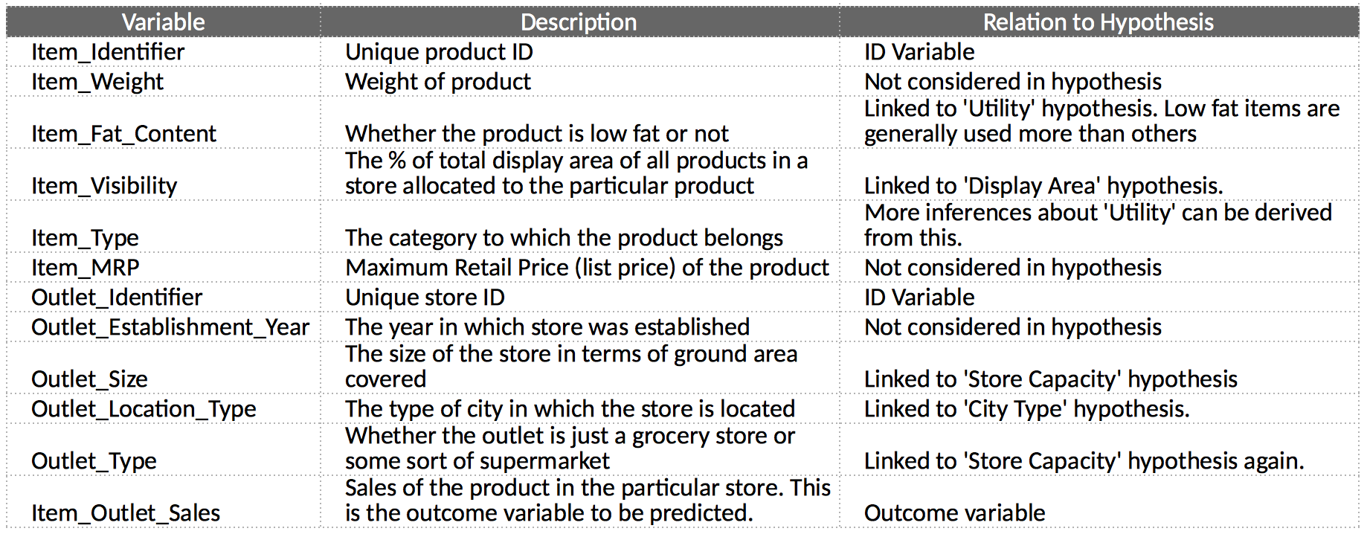
DATASET
The data scientists at BigMart have collected 2013 sales data for 1559 products across 10 stores in different cities.

Slide 16
architecture model
Data Preprocessing
Application
Training data
Predictive model
Inventory automation and optimization
DATASET
Liner Regression Model
Test data
Ridge Regression Model
Data Exploration
Decision Tree Model
Random Forest Model

Slide 17
we have done Data prepossessing in the starting with the project on the inconsistent data set to make it more sensible for our analysis.
Then we have done the Exploratory Data Analysis (EDA) or Data Exploration with the feature engineering methods on the data set and after that we have exported our data into train and test CSV file to train our model.
After exporting the CSV we have created four machine learning models(i.e. Linear Regression Model, Ridge regression Model, Decision Tree model, Random Forest Model) for predicting the sales, then after created those model we have developed an application which will take input from the user (2 inputs are Item ID, Quantity) and it will automatically allocate those inventory items into those outlets so that we will get maximum sales result.

Slide 18
Attributes Analysis
From this first look at the data, the variables that will have higher impact on the products sale price are: Item Visibility , Item Type ,Outlet Size , Outlet Location Type , Outlet Type .
The target variable is Item_Outlet_Sales.
If we look at variable Item Identifier , we can see different group of letters per each product such as FD (Food), DR(Drinks) and NC (Non-Consumable).
Regarding Item Visibility there are items with the value zero . This does not make lot of sense, since this is indicating those items are not visible on the store.
From the 12 features, 5 are numeric and 7 categorical.

Slide 19
Tools and Libraries
The Jupyter Notebook
Qt Designer
Pandas
NumPy
SciPy
scikit
Tools
Libraries

Slide 20
Our goal as a Data Scientist is to identify the most important variables and to define the best regression model for predicting out target variable. Hence, this analysis will be divided into four stages:-
Exploratory data analysis (EDA)
Data Pre-processing
Feature engineering
Modelling

Slide 21
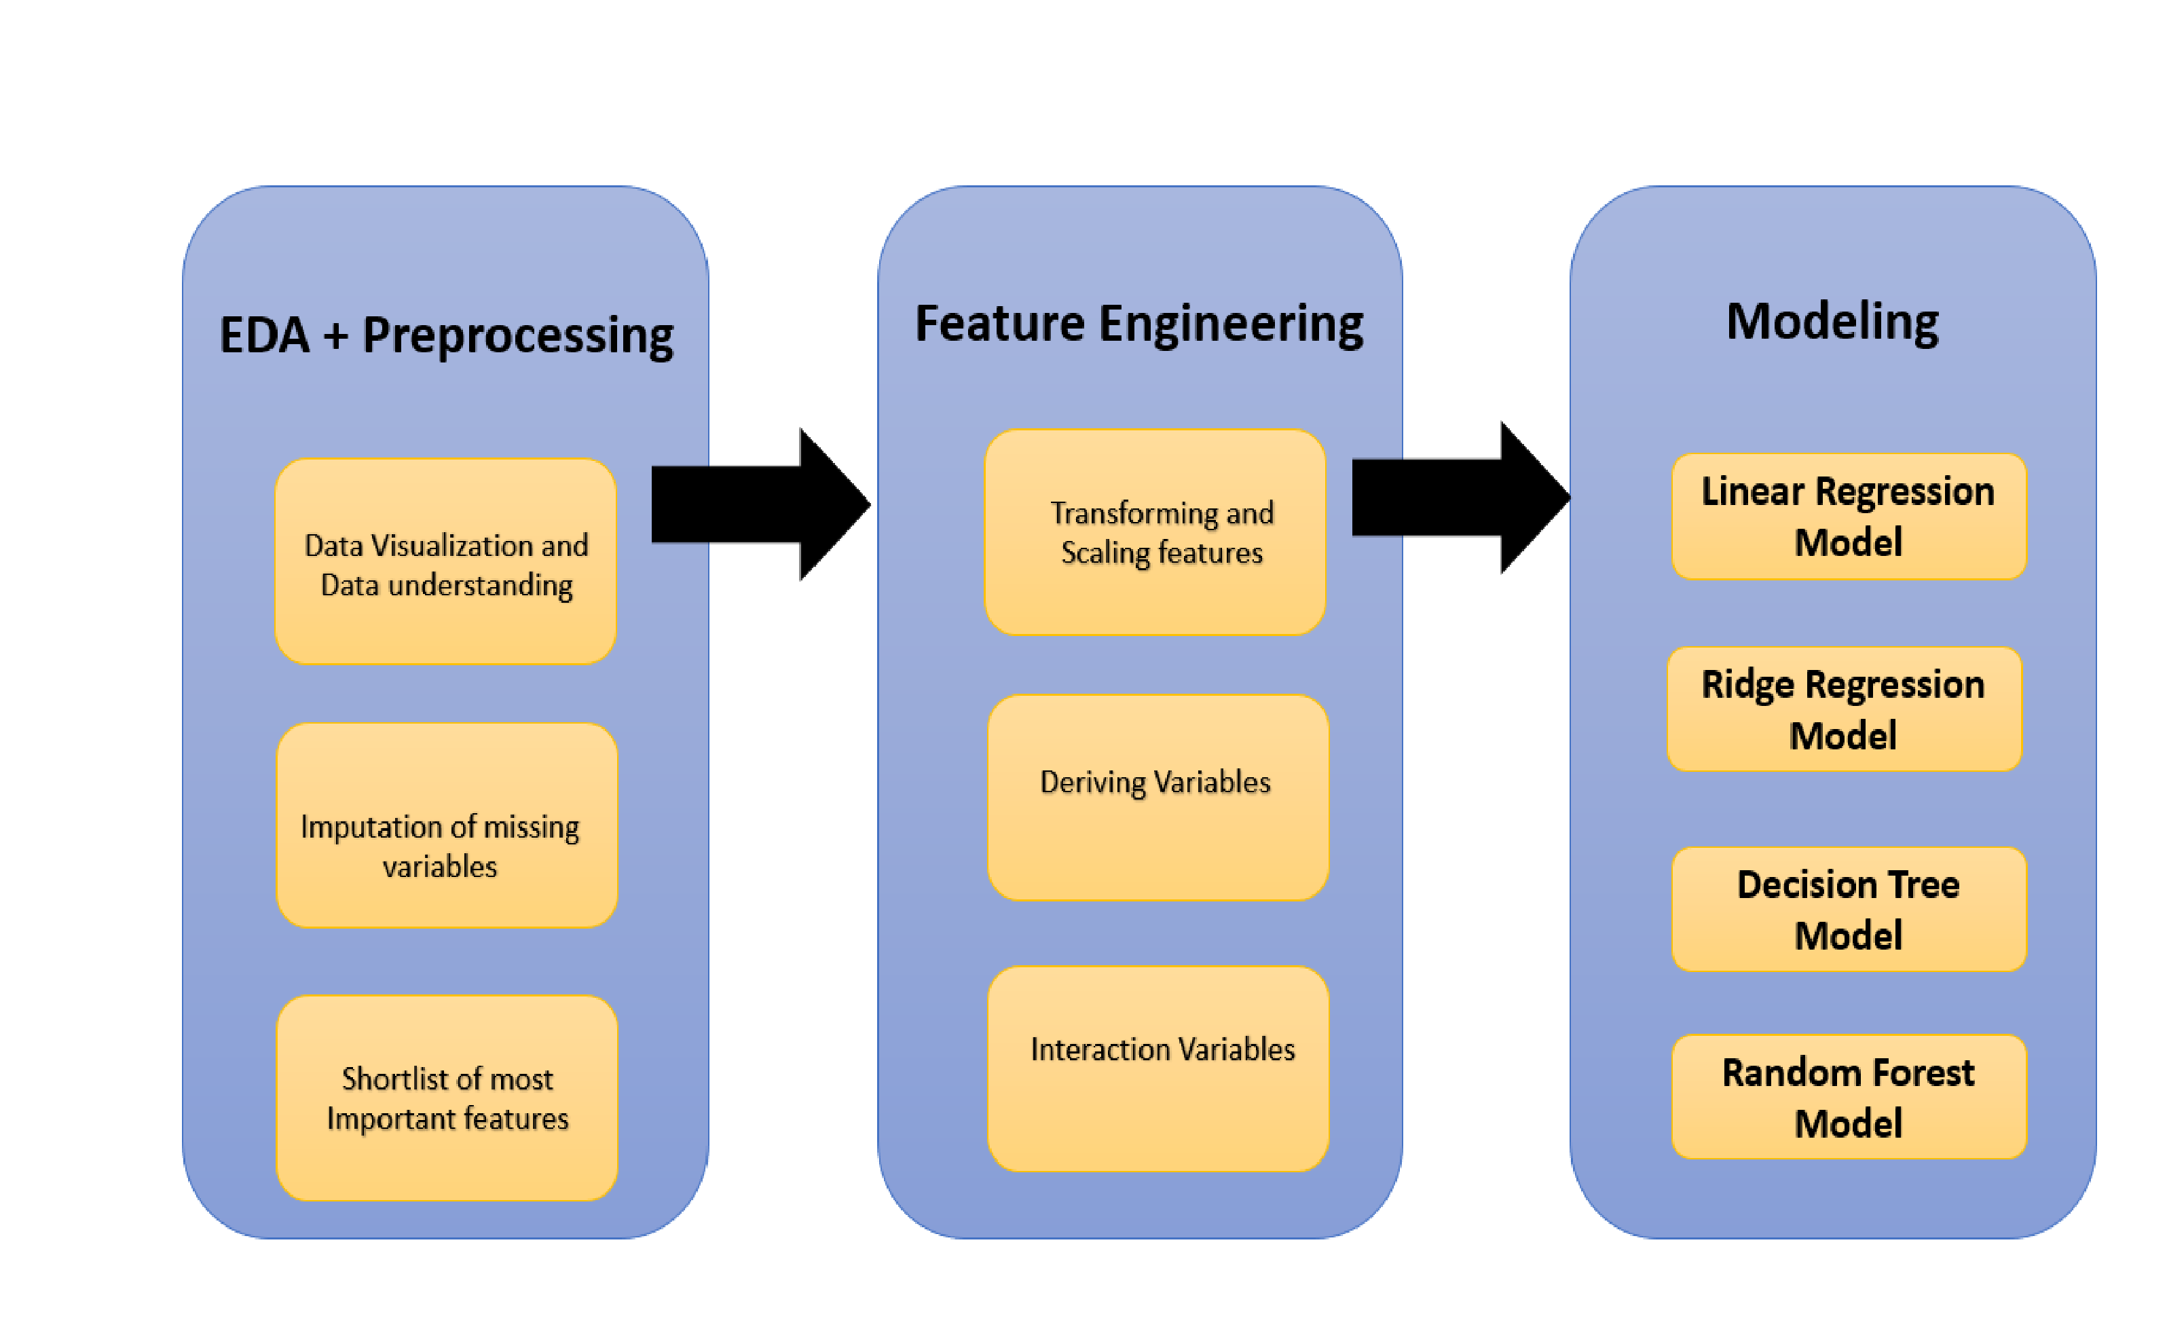

Slide 22
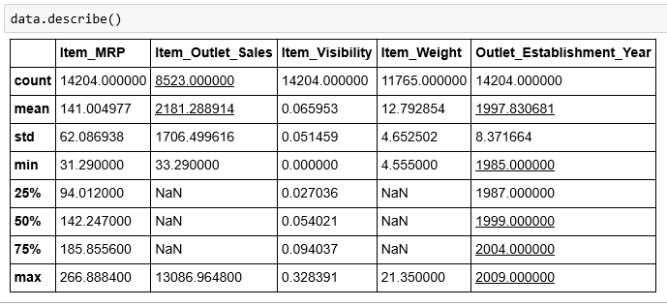
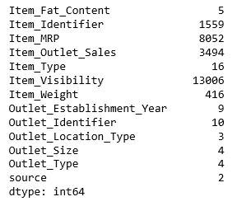
Step 1: Exploratory data analysis (EDA)
Missing Values analysis
Statistics for numerical variables
Frequency distribution

Slide 23
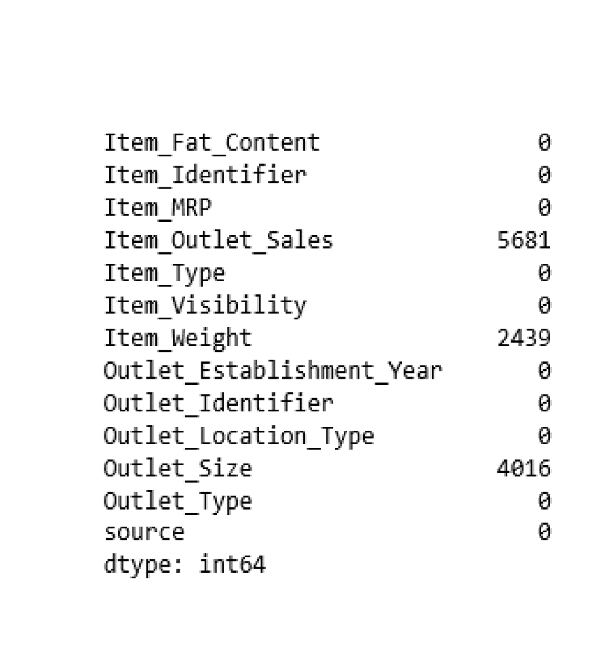
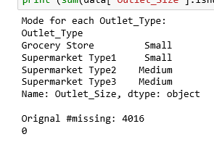
Step 2: DATA Pre-processing
Data Cleaning
Imputing Missing Values

Slide 24
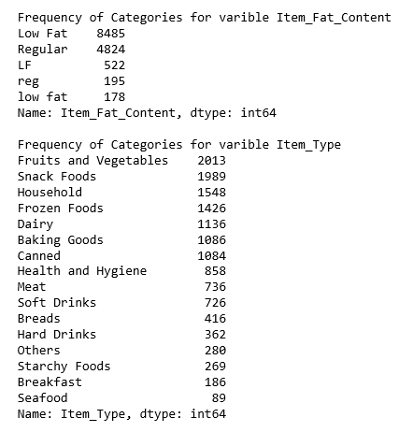
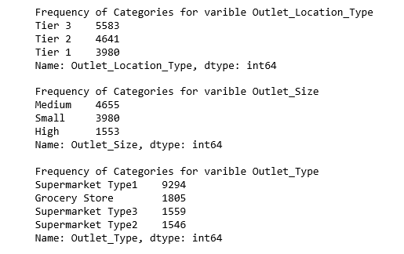
IDEA ?????? Feature Engineering

Slide 25
Step 3: Feature Engineering
Consider combining Outlet Type
Modify Item Visibility
Create a broad category of Type of Item

Slide 26
Step 3: Feature Engineering
Determine the years of operation of a store
Modify categories of Item Fat Content
Numerical and One-Hot Coding of Categorical variables

Slide 27
STEP4: Model Building
Linear Regression Model
Ridge Regression Model
Decision tree Model
Random Forest Model

Slide 28
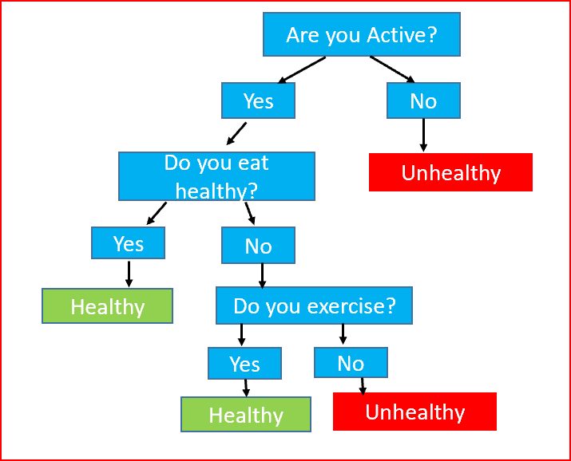
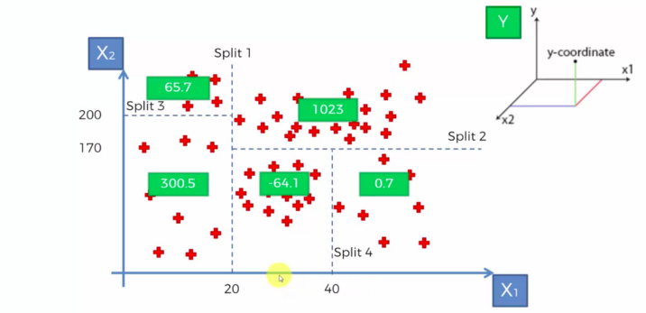

Slide 29
Result and Discussion
smallest locations produced the lowest sales.
However, the largest location did not produce the highest sales.
The location that produced the highest sales was the OUT027 location.
This location was Supermarket Type3 and its size was medium. This outlet performed much better than any other location.
THE location that was second was the OUT035 location.

Slide 30
Result and Discussion
If Big Mart were to try to increase sales at all locations, it may consider switching more locations to Supermarket Type3. Other things Big Mart could do to increase sales is to see which Items had the highest sales.
They may also consider how product visibility affected outlet sales.
However, the model built in this report should be good for helping Big Mart predict future sales at its locations.

Slide 31
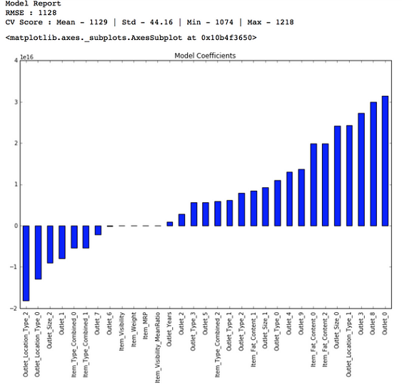
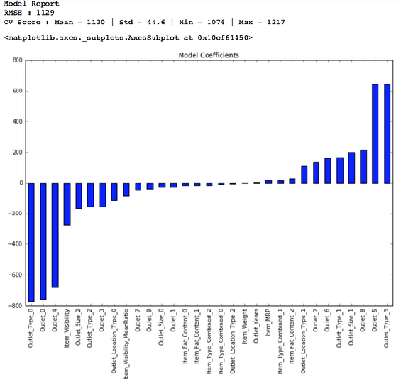
Linear Regression Model
Ridge Regression Model

Slide 32
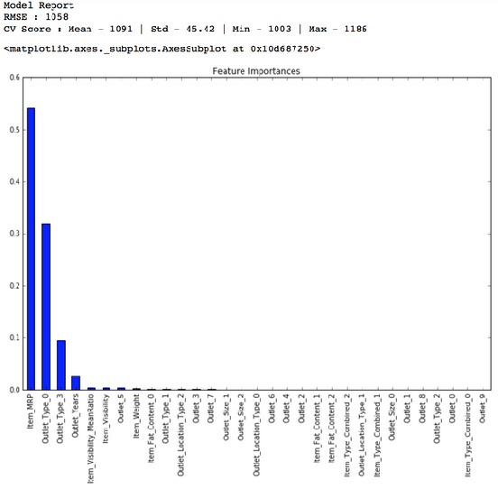
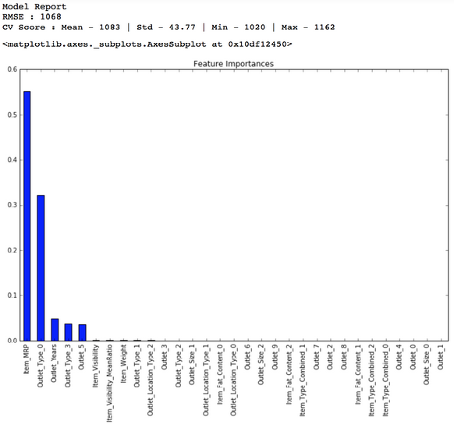
Decision Tree Model
Random Forest Model

Slide 33
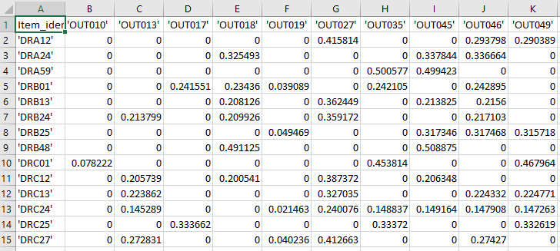

Slide 35
references
[1] Traffic Management using Logistic Regression with Fuzzy Logic, AS Tomar, M Singh, G Sharma, KV Arya -Temporal Data Mining via Unsupervised Ensemble Learning, Procedia Computer Science, 2018 – Elsevier
[2] Multi-Objective Evolutionary Feature Selection for Online Sales Forecasting
Volume 234, Pages 75-92 Neurocomputing, Elsevier , 19 April 2017
[3] Towards Context Aware Food Sales Prediction, 2009 IEEE International Conference on Data Mining Workshops
[4] A Comparative Study of Supervised Machine Learning Algorithms for Stock Market Trend Prediction, 2018 Second International Conference on Inventive Communication and Computational Technologies (ICICCT), IEEE 27 September 2018
[5] A survey of machine learning techniques for food sales prediction, S Ren, CP Hui, TJ Choi -Artificial Intelligence Review, Artificial Intelligence for Fashion Industry in the sales prediction 2018 – Springer

Slide 36
references
[6] General Sales Forecast Model for Automobile Markets and their Analysis, Industrial Conference on Data Mininng , ICDM 2011, Springer M Hülsmann, D Borscheid, CM Friedrich, D Reith - Trans. MLDM, Page 255-269
[7] An Optimization Approach to Services Sales Forecasting in a Multi-staged Sales Pipeline, June 2016 , IBM Almaden Research Center, IEEE International Conference on Services Computing (SCC)
[8] Random forests resource allocation for 5G systems: Performance and robustness study, 2018 IEEE Wireless Communications and Networking Conference Workshops (WCNCW), 31 May 2018
[9] Sales Forecast for O2O Services - Based on Incremental Random Forest Method, 2018 15th International Conference on Service Systems and Service Management (ICSSSM) , July 2018
[10] A Deep Learning Approach for the Prediction of Retail Store Sales, Yuta Kaneko, katsutoshi yada, 2016 IEEE 16th International Conference on Data Mining Workshops (ICDMW)
[11] An Optimization Approach to Services Sales Forecasting in a Multi-staged Sales Pipeline, Aly Megahed, Peifeng Yin, Hamid Reza Motahari Nezhad, 2016 IEEE International Conference on Services Computing (SCC), July 2016

Slide 37
REFERENCES
[12] ShanShan Wang, YouLi Feng, A forecast for bicycle rental demand based on random forests and multiple linear regression. IEEE, 2013.
[13] Yanming Yang. Prediction and analysis of aero-material consumption based on multivariate linear regression model. 3rd IEEE International Conference on Cloud Computing and Big Data Analysis, 2018.
[14] M. Costa P. Kela, J. Turkka. Borderless mobility in 5g outdoor ultra-dense networks. IEEE, pages 1462{1476, 2015.
[15] Guangwu Hu Yongzhong Huang Jiangtao Ma, Yaqiong Qiao. De anonymizing social networks with random forest classier. IEEE Access, Vol 6, p-10139-10150, 2017.

